Slide 1
WEB

Slide 2


<div class="new">
<div class="new_cnt">
<a href="https://cityu.edu.mo/zh/1nov2024_02/" target="_blank" title="祝賀！城大學子在公益廣告創意大賽中獲得佳績">
<img width="1493" height="1018" src="images/cityu20241105181011627492.jpg" class="attachment-full size-full" alt="" />
<div class="describe">
<p>祝賀！城大學子在公益廣告創意賽中獲得佳績</p>
</div>
</a>
</div>
title属性

Slide 3
@media (min-width: 360px) and (max-width: 479px) {
.a_apply .new {
display: flex
;
flex-direction: column;
align-items: center;
}
}
@media (min-width: 360px) and (max-width: 479px) {
.a_apply .new .new_cnt {
width: 360px;
margin-right: 0px !important;
}
}

Slide 4
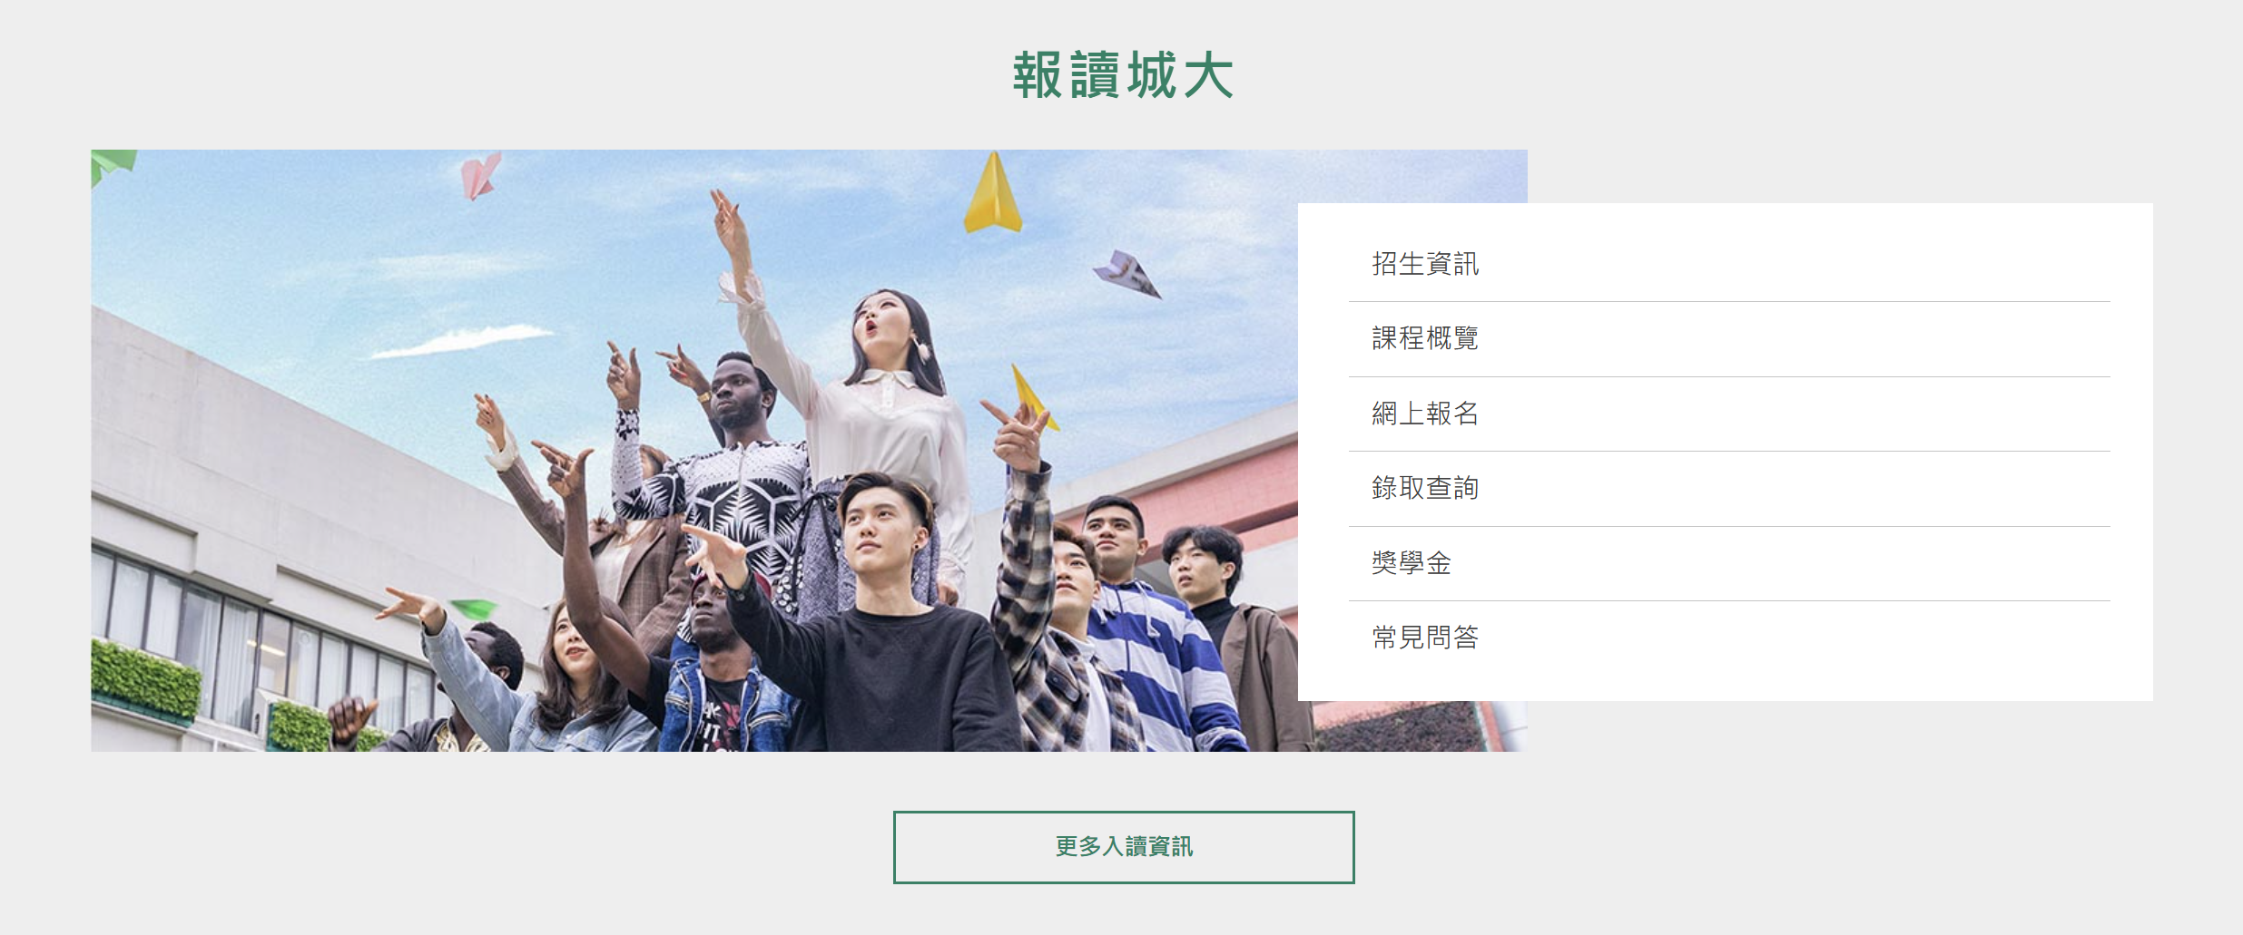
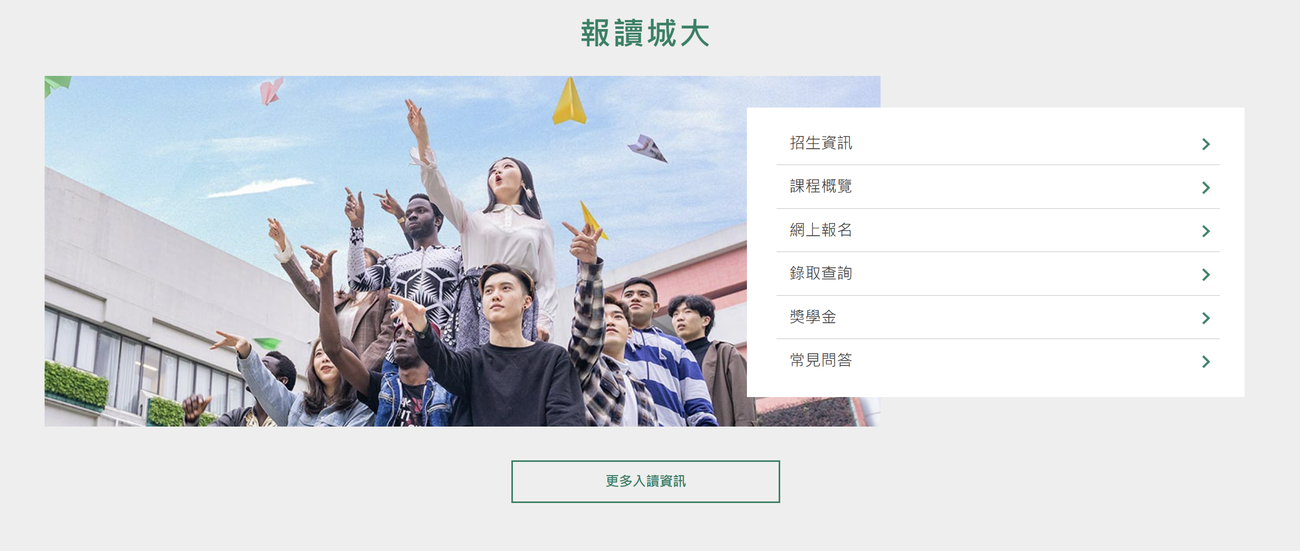
<div class="exam">
<ul id="menu-%e6%8b%9b%e7%94%9f%e8%b3%87%e8%a8%8a" class="exams-list">
<li id="menu-item-19260" class="menu-item menu-item-type-custom menu-item-object-custom menu-item-19260">
<a target="_blank" rel="noopener noreferrer" href="https://ado.cityu.edu.mo">招生資訊</a>
</li>
<script type="text/javascript">
$(".exams-list li").addClass("item");
var applyLgh=$(".exams-list li").length;
for (var i = 1; i<=applyLgh; i++) {
$(".exams-list .item a").eq(i-1).after('<span class="imgdiv"><img src="images/right_arrow.png" alt="" target="_blank" width="10px"/></span>')
}
</script>

